Slide 1
Object Oriented Programming Lab #12 Understanding the concept of Exceptions
ENGR. SANIYA SARIM

Slide 2
Java Exceptions
When executing Java code, different errors can occur: coding errors made by the programmer, errors due to wrong input, or other unforeseeable things.
When an error occurs, Java will normally stop and generate an error message. The technical term for this is: Java will throw an exception (throw an error).

Slide 3
Java try and catch
The try statement allows you to define a block of code to be tested for errors while it is being executed.
The catch statement allows you to define a block of code to be executed, if an error occurs in the try block.
The try and catch keywords come in pairs:

Slide 4
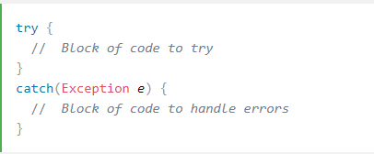
Syntax

Slide 5
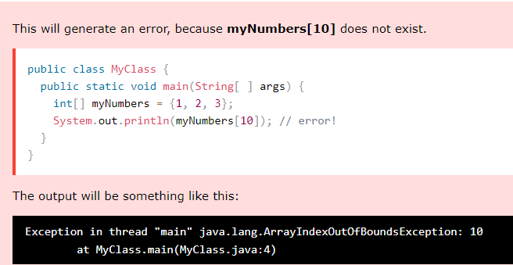
Example

Slide 6
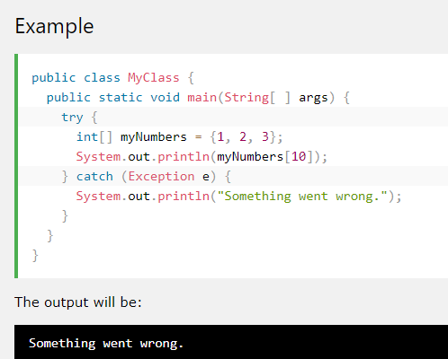
If an error occurs, we can use try...catch to catch the error and execute some code to handle it:

Slide 7
Finally
The finally statement lets you execute code, after try...catch, regardless of the result:

Slide 8
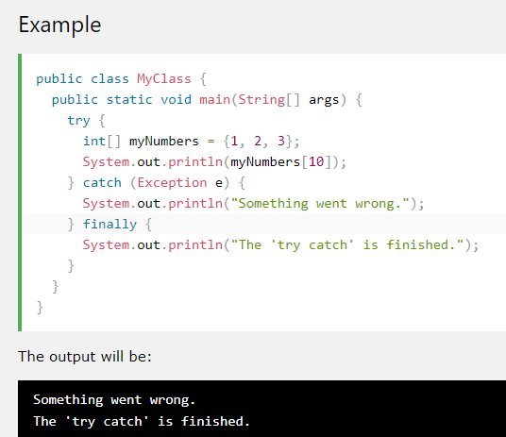
Example of finally keyword

Slide 9
Types Of Exceptions in Java
There are many different Java Exception errors. Some examples below;
•IOException - I/O exception error
•RunTimeException - Run-time error
•ArithmeticException - Divide-by-zero error exeception
•ArrayIndexOutOfBoundsExecption - Array index out of bounds error
•FileNotFound - Attempt to get file that does not exist
•EndOfFileException - End of file marker error

Slide 10
The throw keyword
The throw statement allows you to create a custom error.
The throw statement is used together with an exception type. There are many exception types available in Java: ArithmeticException, FileNotFoundException, ArrayIndexOutOfBoundsException, SecurityException, etc:

Slide 11
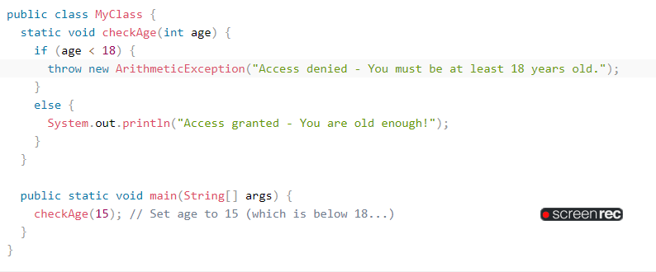
Example of Throw Keyword

Slide 12

Output

Slide 13
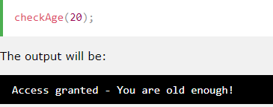
If age was 20, you would not get an exception:

